Slide 1
Teeth segmentation in Computer Vision
Rafael Mestre Castillo

Slide 2
Introduction
Three main parts:
Global segmentation of the jaw
Central teeth segmentation
Active Shape Model
14 train images, 16 test images

Slide 3
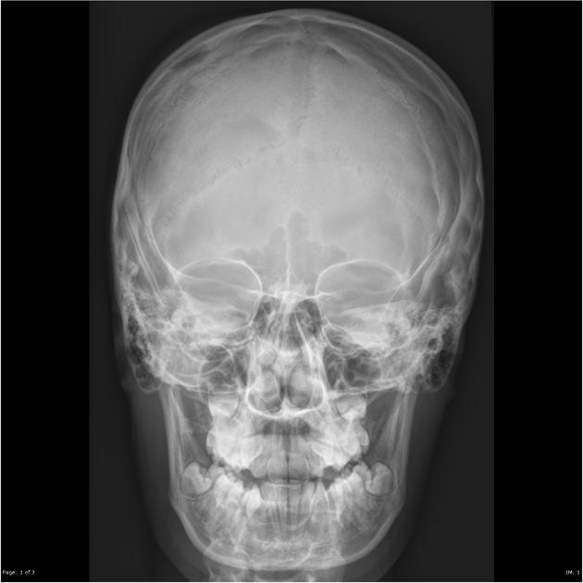
Global segmentation
Sometimes X-ray dental images might be centered at different positions → necessity of locating the jaw
Left: skull radiograph, source: http://radiopaedia.org. Right: sample 12

Slide 4
Global segmentation
Sometimes X-ray dental images might be centered at different positions → necessity of locating the jaw
Left: sample 22. Right: sample 12

Slide 5
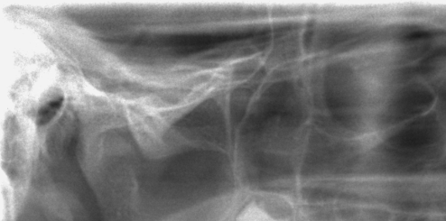
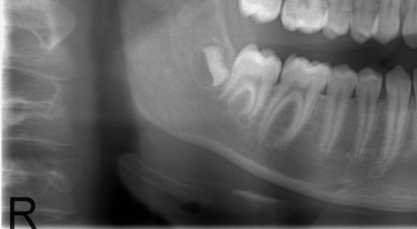
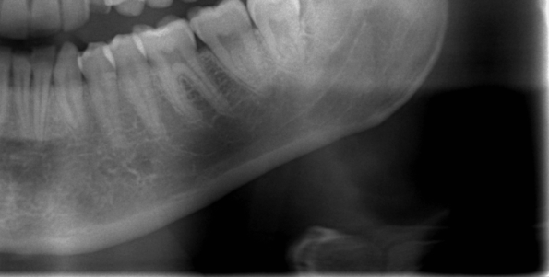
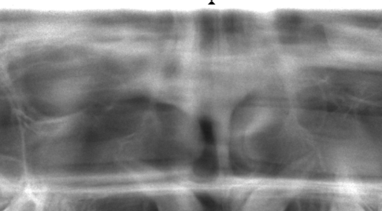
Global segmentation: procedure
Not the most crucial step → speed and simplicity
Principal Component Analysis (PCA): positive database (14 images) and negative database (64 images)

Slide 6
Global segmentation: procedure
Not the most crucial step → speed and simplicity
Principal Component Analysis (PCA): positive database (14 images) and negative database (64 images)
Resizing → 210x100 sliding window (steps of 3, 5, 8, 10 and 15 pixels)
Simple classifier → Euclidean distance

Slide 7
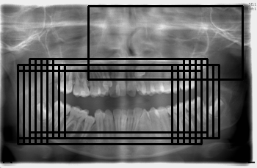
Global segmentation: multidetections
Multidetections of the jaw and false positives
Sample 22.

Slide 8
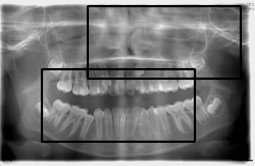
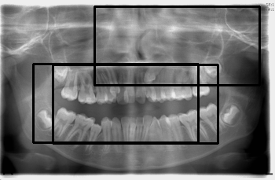
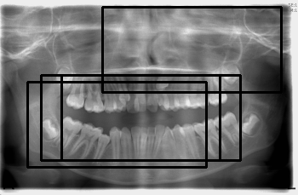
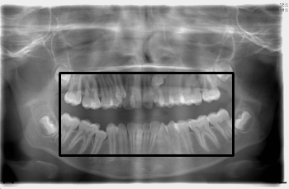
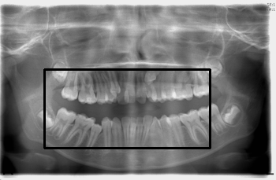
Global segmentation: multidetections
Manual clustering
Affinity propagation
Take the median
Sample 22.

Slide 9
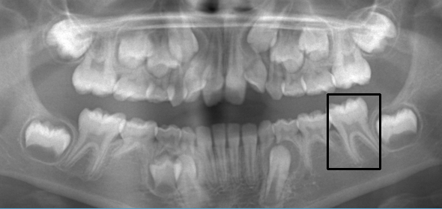
Central teeth segmentation
Active shape model needs a very good starting point
Using the center of the cropped image as a guide to segment the upper and lower incisors
Other methods did not yield very good results
Sample 19.

Slide 10
Central teeth segmentation: preprocessing
Non-local means denoising
Sample 20

Slide 11
Central teeth segmentation: preprocessing
Non-local means denoising
Canny edge detection + morphological dilation
Sample 20

Slide 12
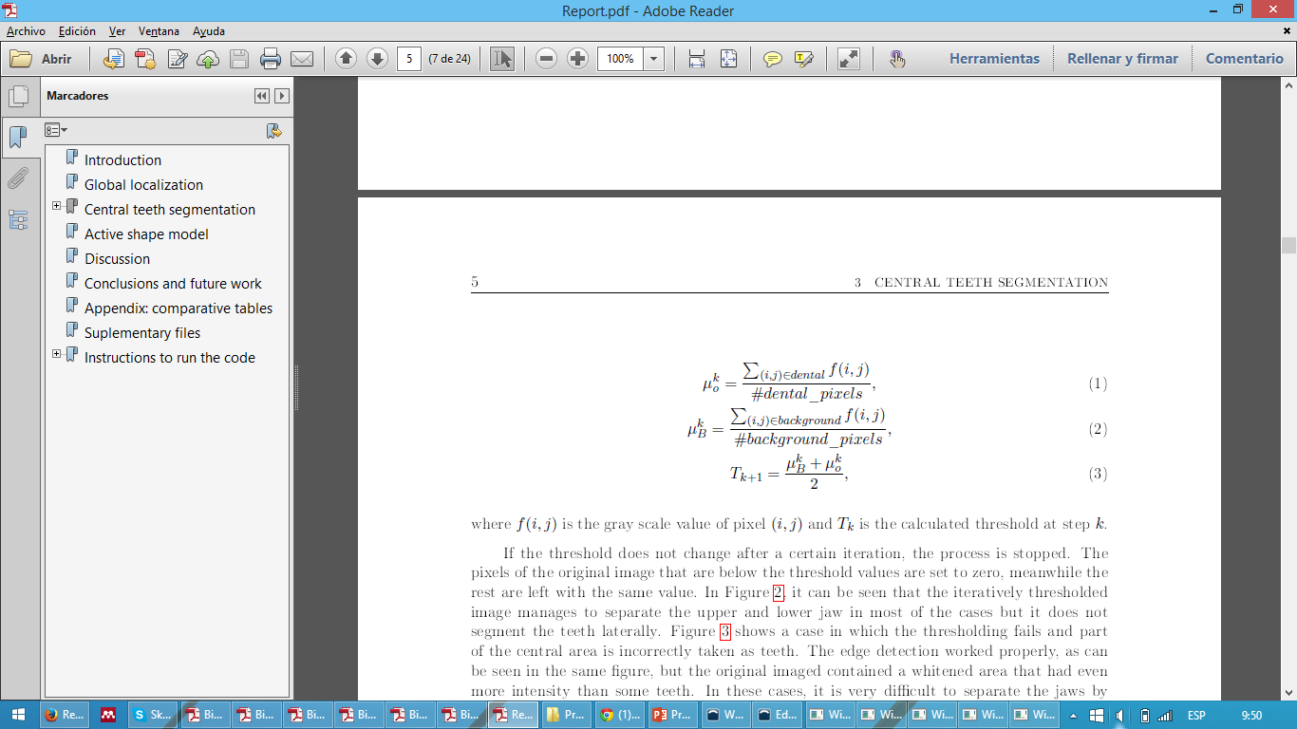
Central teeth segmentation: preprocessing
Non-local means denoising
Canny edge detection + morphological dilation
Iterative thresholding
Sample 20 and sample 22

Slide 13
Central teeth segmentation: preprocessing
Non-local means denoising
Canny edge detection + morphological dilation
Iterative thresholding
Adaptive Gaussian thresholding
Sample 20 and sample 22

Slide 14
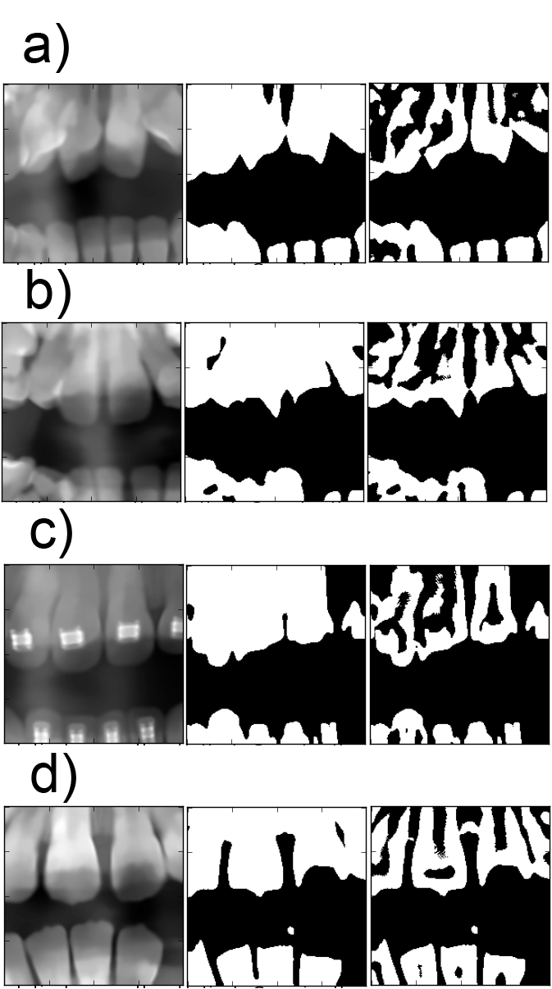
Central teeth segmentation: examples
a) Sample 19; b) Sample 21; c) Sample 27; c) Sample 28.

Slide 15
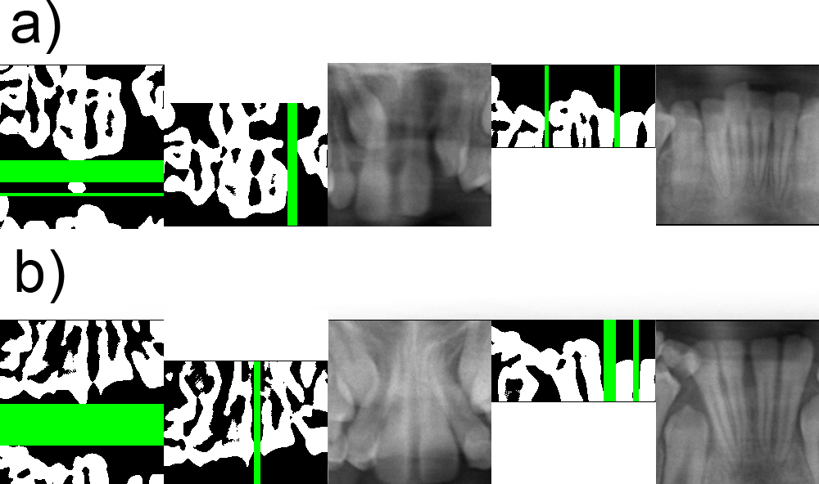
Central teeth segmentation: projections
a) Sample 16; b) Sample 21.

Slide 16
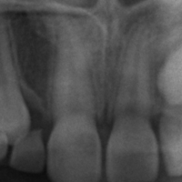
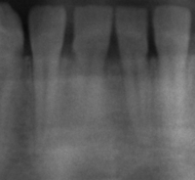
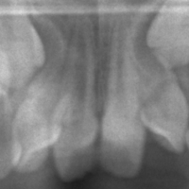
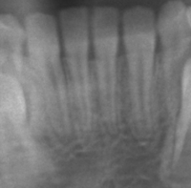
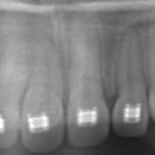
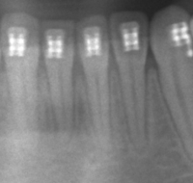
Central teeth segmentation: examples
From top to bottom: sample 15, sample 19, and sample 27.

Slide 17
Active shape model
40 landmarks per tooth
Procrustes analysis → normalizing position, scale and rotation
PCA → 99% of variance
Starting point → computed in last method
Multi-resolution approach
Fit 4 teeth → fit 2 teeth → fit tooth individually
Extensive feedback

Slide 18
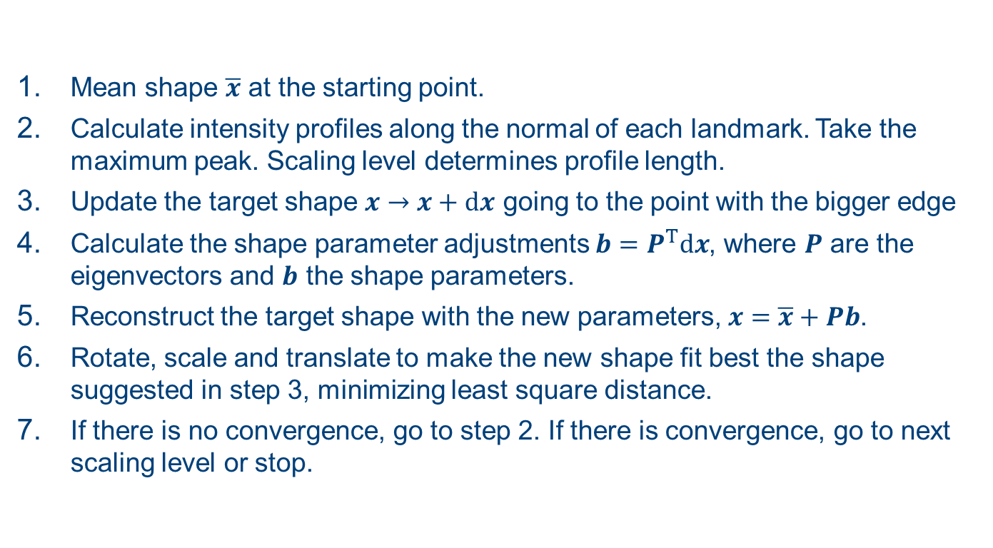
Active shape model: method
Mean shape $\overline{x}$ at the starting point.
Calculate intensity profiles along the normal of each landmark. Take the maximum peak. Scaling level determines profile length.
Update the target shape $x→x+dx$ going to the point with the bigger edge
Calculate the shape parameter adjustments $b=P^{T}dx$, where $P$ are the eigenvectors and $b$ the shape parameters.
Reconstruct the target shape with the new parameters, $x=\overline{x}+Pb$.
Rotate, scale and translate to make the new shape fit best the shape suggested in step 3, minimizing least square distance.
If there is no convergence, go to step 2. If there is convergence, go to next scaling level or stop.

Slide 19
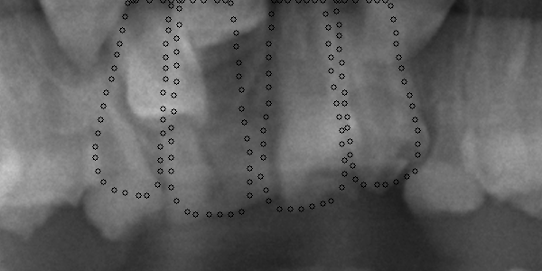


Active shape model: examples
4 teeth at the same time
2 teeth at the same time
Individually reconstructed
Sample 18

Slide 20
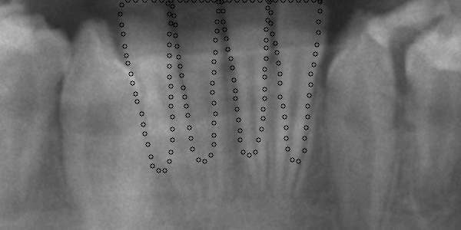


Active shape model: examples
4 teeth at the same time
2 teeth at the same time
Individually reconstructed
Sample 18

Slide 21
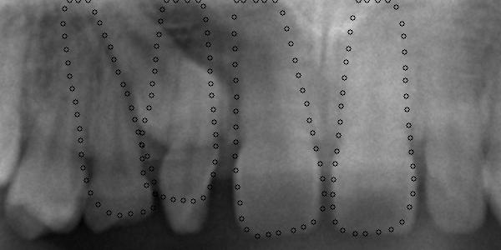
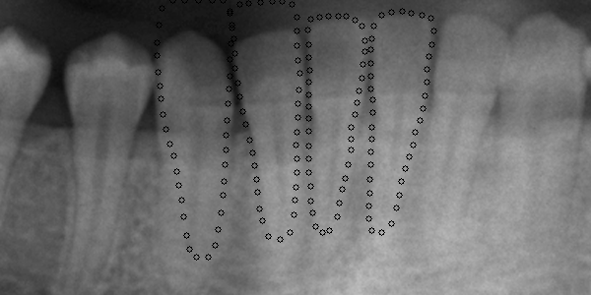
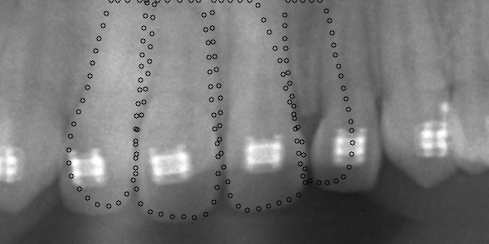
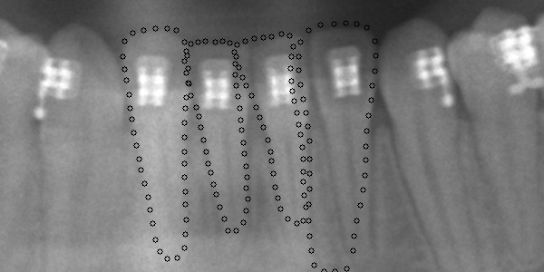
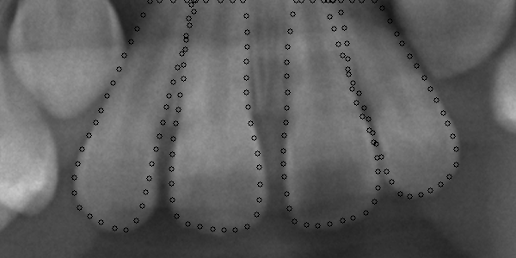
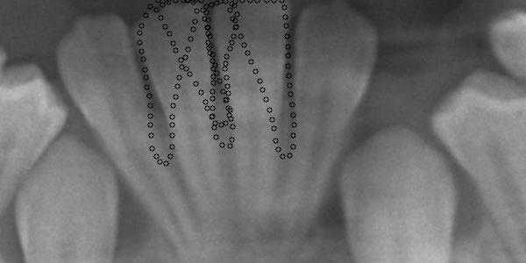
Active shape model: examples
From top to bottom: samples 20, 27, and 28.

Slide 22
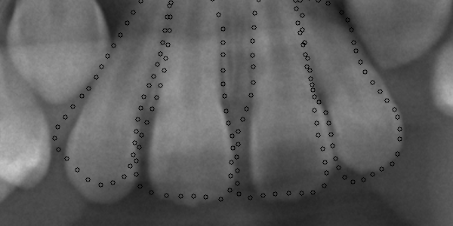
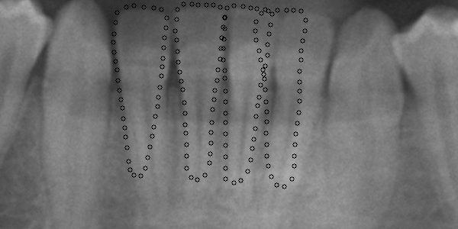

Active shape model: examples
Individually reconstructed
Reconstructed with PDM
Top: sample 28. Bottom: sample 30.

Slide 23




Active shape model: examples
Sample 28.

Slide 24
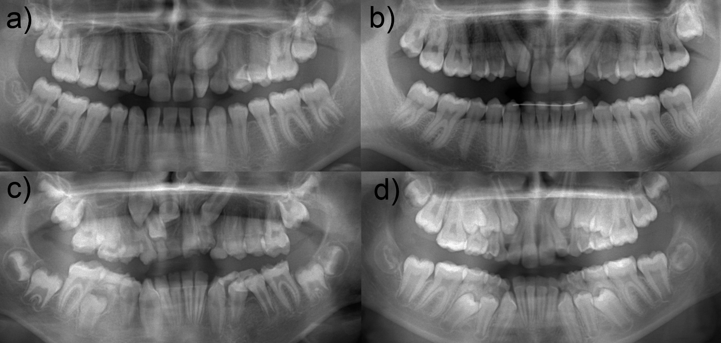
Statistics: global segmentation
100%
a) Sample 15; b) sample 17; c) sample 18; and c) sample 23.

Slide 25
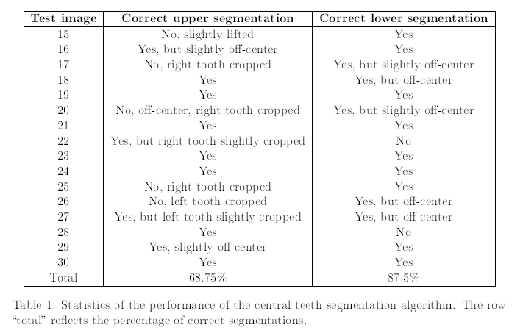
Statistics: central segmentation
Top: sample 28. Bottom: sample 30.

Slide 26
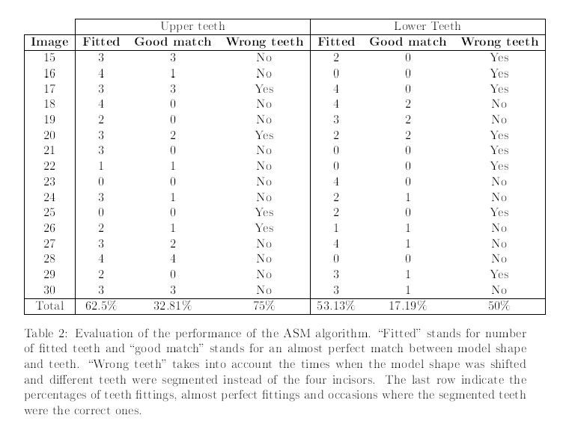
Statistics: active shape model
Top: sample 28. Bottom: sample 30.

Slide 27
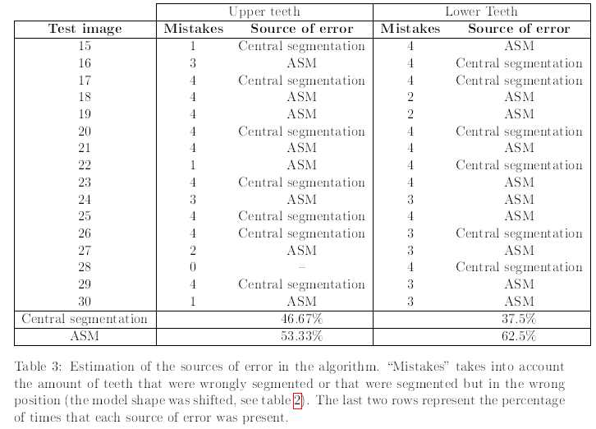
Statistics: sources of error
Top: sample 28. Bottom: sample 30.

Slide 28
Conclusions
Global segmentation: fast, easy algorithm → 100%
Central teeth segmentation: very fast, not perfect (side teeth cropped, off-center…) → 68,75% and 87,5%
Active shape model: takes some time, several steps to get feedback → 62,5% and 53,13% approximately fitted, but sometimes wrong teeth
A lot of room for improvement:
Different thresholding algorithms, allowing rotating image, using position of molars…
Constraints on the rotation and migration, adds weights, eliminate fuzzy edges of nearby teeth, use machine learning algorithms to get better feedback…

Slide 29
Thank you

